Slide 1
Reciprocity and Inter-Reciprocity
Gabor Temes and Eric Wang
Fall 2023
Notes:
1
1

Slide 2
KCL
The KCL (Kirchhoff’s Current Law)
States that the sum of the currents leaving each node is zero
Define branch currents as I = [i₁, i₂, …, i_{b} ]^{T}
Ai = 0
Where b is the number of branches in the circuit, 0 is the column vector of zeros
Define the incidence matrix A
$a_{ij}=\left\{\begin{aligned}+1 if branch j leaves node i \\ −1 if branch j enters node i \\ 0 if branch j is not incident at node i\end{aligned}\right.$
Notes:
2
2

Slide 3
KVL
The KVL (Kirchhoff’s Voltage Law):
States that the voltage across a branch is the difference of the node voltages at the terminals of the branch.
Denote v and e as the branch and node voltages, respectively. KVL gives
v = A^{T}. e
Notes:
3
3

Slide 4
Tellegen’s Theorem
Consider the total power developed in all branches of the circuit shown below
$\sum_{k=1}^{N}{v_{k}i_{k}= v^{T}.}i={\left(A^{T}e\right)}^{T}i= e^{T}\left(Ai\right)$ = 0
Conservation of the power
In any network, the summation of power is zero.
Applications
Impedance synthesis, sensitivity analysis and noise computation
Notes:
4
4

Slide 5
Using Tellegen’s Theorem in N-ports
Consider two N-ports N and N’ with the same A matrices. The previous equations give
$$\sum{v_{k}{i′}_{k}+ v^{T}i^{′} }=Pp +Pb=0$$
$$\sum{{v′}_{k}i_{k}+ {v′}^{T}i^{′} }=Pp′ +Pb′=0$$
Here, Pp refers to the quantities in the branches at the port and Pb refers to those inside the N-port in N. The primed quantities Pp’ and Pb’ refer to the equivalent ones in N’.

Slide 6
Using Tellegen’s Theorem in N-ports
If the inside structures of N and N’ are such that Pb = Pb’, then Pp = Pp’ also holds. The port voltages and currents satisfy this condition, or
$$\sum{i_{k}v_{k}^{′}}=\sum{i_{k}^{′}v_{k}}$$
where i_{k} and v_{k} are the port currents and voltages under one set of excitations, while i_{k}’ and v_{k}’ are those under a different one, for the same N-port. Then, relations can be found between the transfer functions of the N-port!
Such an N-port circuit is called reciprocal.

Slide 7
Two-Port Example-1
Assume the following two circuits
contain only linear resistors, no controlled sources
have same internal branches, but different terminations
Tellegen’s Theorem gives
$$\text{−}\text{v}\text{2}\text{.}\text{i}\text{2}\text{′} \text{+ ∑}\text{v}\text{k}\text{.}\text{i}\text{k}\text{′}\text{ =} \text{−}\text{v}\text{2}\text{.}\text{i}\text{2}\text{′+ ∑}\text{i}\text{k}\text{.}\text{R}\text{k}\text{.}\text{i}\text{k}\text{′}\text{=0}$$
$\text{v}\text{1}\text{′}\text{.}\text{i}\text{1} \text{+ ∑}\text{i}\text{k}\text{.}\text{R}\text{k}\text{.}\text{i}\text{k}\text{′=0}$
Subtracting the two gives: $\text{v}\text{2}\text{.}\text{i}\text{2}\text{′ = }\text{v}\text{1}\text{′}\text{.}\text{i}\text{1}$ $⇒$ Reciprocal
Example:
Circuit N
Circuit N’
Notes:
7
7

Slide 8
Two-Port Example-2
Thus, a two-port containing only resistors is reciprocal.
Next, the port relations of N and N’ are found for another two-port
$$\left\{\begin{aligned}\sum{i_{k}v_{k}^{′}}=\sum{i_{k}^{′}v_{k}} \\ \text{i}\text{2} \text{= }\text{i}\text{1}\text{’ = 0}\end{aligned} ⇒ \left\{\begin{aligned}i_{1}v_{1}^{′}=i_{2}^{′}v_{2} \\ v_{2}/i_{1}=v_{1}^{′}/i_{2}^{′}\end{aligned}\right.\right.$$
Note that $v_{2}/v_{1}≠v_{2}^{′}/v_{1}^{′}$!
Circuit N
Circuit N’
Notes:
8
8

Slide 9
Two-Port Example-2
The forward transfer of N equals the reverse transfer function of N’ only if the source impedances at the ports are the same
Thus, a voltage source in N should be replaced by a short circuit in N’, and a current source replaced by an open circuit:
Circuit N
Circuit N’
Circuit N
Circuit N’
Notes:
9
9

Slide 10
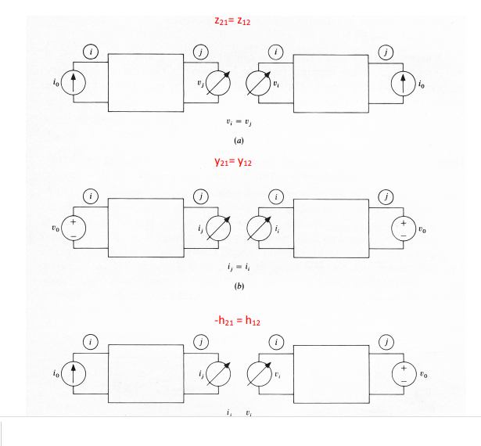
Equal-impedance Termination
Gains are equal. Valid also if two-ports are turned around.
Notes:
10
10

Slide 11
Reciprocity In Dynamic N-Ports
Steady-state sine wave analysis represents voltages and currents by complex phasors V(jω), I(jω) in a linear circuit, and represents passive elements by their impedances Z_{k}(jω).
KCL, KVL and all previous derivations hold for the phasors.
Useful in the analysis of passive dynamic networks with multiple excitations, e.g., DACs (Digital-to-Analog Converters) design
Notes:
11
11

Slide 12
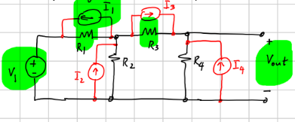
Examples Using Reciprocity
Below shows a circuit containing five independent sources
Analyze using superposition
Requires five analysis, each with one nonzero source
Analyze using reciprocity
Requires only one circuit analysis
Notes:
12
12

Slide 13
Analyzing Circuits Using Reciprocity
The contribution of the voltage source $V_{1}$ to the output $v_{out}$
$${v_{out}}/{V_{1}}=i_{1}/I$$
and those of the current sources $I_{k}$ are
$${v_{out}}/{I_{k}}={v_{k}}/I, k=1,2,…,5$$
The overall output voltage is the sum of these terms.
Notes:
13
13

Slide 14
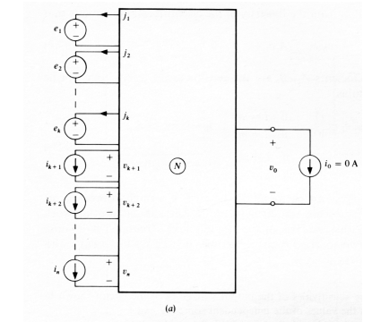
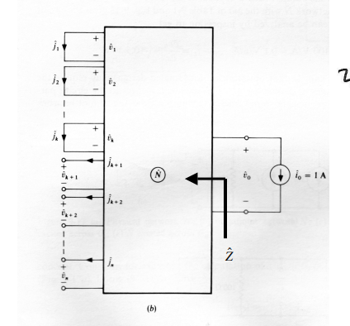
Using Reciprocity in Analysis
Using $\sum{i_{k}v_{k}^{′}}=\sum{i_{k}^{′}v_{k}}$, you find that the output voltage vo is
the weighted sum of the input source values. The weight of ei is –ji’ , and that ik is vk. Also, Zo is the same, so the Thevenin equivalent is readily found. No MNA needed!

Slide 15
Generalized Method
To analyze a reciprocal circuit containing several independent sources:
Redraw the circuit, setting the values of all independent sources to zero. Thus, voltage sources become short circuits, current sources open circuits in N’.
Replace the output signal with an independent source. Replace voltage with a current source I ; replace current with a voltage source V (e.g., I = -1A, or V= 1V)
Analyze the transformed network. The desired result will be the weighted sum of the independent source values in the physical circuit, with the weight factor of each current source the voltage across its zero valued replica, and that of each voltage source the current flowing across its short-circuit replica.
Notes:
15
15

Slide 16
Resistive N-Ports
Assume an N-port circuit containing only resistors. To achieve Pb = Pb’ for reciprocity, N’ must satisfy
$$v_{B}^{T}∙G^{′}∙v_{B}^{′}={\left(v_{B}^{′}\right)}^{T}∙G∙v_{B}$$
where G is the branch admittance matrix connecting the internal branch voltages and currents in N by $i_{B}=G∙v_{B}$, and similarly $i_{B}′=G′∙v_{B}$’.
Since the quantities on both sides are scalars, it is permissible to take the transpose of the right side. This gives
$$v_{B}^{T}∙G^{′}∙v_{B}^{′}=v_{B}^{T}∙G^{T}∙v_{B}^{′} ⇒G^{′}=G^{T}$$
Hence, to achieve Pb = Pb’ ,the branch admittance matrix $G^{′}$ of $N^{′}$ must be the transpose of $G.$ If the circuit contains only resistors, G is symmetric, so $G^{T}$ = G, and reciprocity is assured.
Notes:
16
16

Slide 17
Inter-Reciprocity and its Applications
If the circuit contains controlled sources, N’ cannot be the same as N. The reciprocity conditions fail for using the same N-port as N’, since the G matrix will not be symmetric. N’ must be chosen so as to restore $G^{′}=G^{T}$.
An adjoint network is a modified version N’ of the physical network N, which is constructed such that the reciprocity condition on the port currents and voltages
i₁v₁’ + i₂v₂’ = i₁’v₁ + i₂’v₂
is restored for the two networks. By Tellegen’s theorem, this requires the condition $\sum{i_{k}v_{k}^{′}}=\sum{i_{k}^{′}v_{k}}$ to be valid separately for both port and interior branches. The relation between N and N’ is called inter-reciprocity.
Notes:
17
17

Slide 18
Inter-Reciprocity in R-VCCS N-Port
To satisfy Pb = Pb’ , we must have
$$i_{a}v_{a}^{′}+i_{b}v_{b}^{′}=i_{a}^{′}v_{a}+i_{b}^{′}v_{b}$$
which can be used to find the two branches in N’ corresponding to the VCVS
For the VCCS, the branch relations are
$$i_{a}=0 and i_{b}=g_{m}v_{a}$$
The above two equations give the reciprocity condition which is
$$i_{a}^{′}−g_{m}v_{b}^{′}=−i_{b}^{′}(v_{b}/v_{a})$$
Notes:
18
18

Slide 19
Inter-Reciprocity
The equation derived must hold true for all values of $v_{b}/v_{a}$
$$i_{a}^{′}−g_{m}v_{b}^{′}=−i_{b}^{′}(v_{b}/v_{a})$$
Only possible when
$$i_{b}^{′}=0 and i_{a}^{′}=g_{m}v_{b}^{′}$$
The image in N’ of the VCCS of circuit N is thus another VCCS but turned around!
If there are several VCCS’s in N, then the adjoint network N’ must contain such appropriately modified replicas (i.e., turned around VCCS stages) for all of them.
Notes:
19
19

Slide 20
Modified Generalized Method
To analyze multi-source active networks using inter-reciprocity:
Draw the adjoint circuit N’, setting the values of all previous independent sources to zero. Thus, voltage sources become short circuits, current sources open circuits.
Replace the original output signal with an independent source. If it is voltage, replace it with a current source I ; if it is a voltage source, with a voltage source V (e.g., I = -1A, or V= 1V).
Analyze the adjoint network N’. The desired result for the output in N will be the weighted sum of the independent source values in N with the weight of each current source the voltage across its zero valued replica, and that of each voltage source the current flowing across its short-circuit replica.
Notes:
20
20

Slide 21
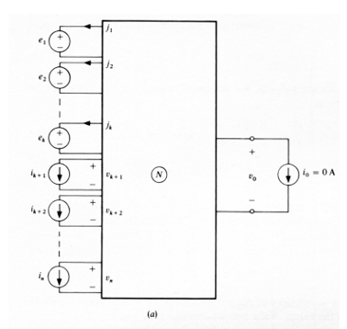
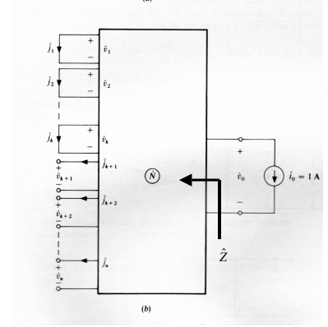
Applications of Inter-Reciprocity
Inter-reciprocity can also be used to efficiently obtain the Thevenin equivalent of a linear circuit with multiple independent and dependent sources.
Obtain the output impedance Z of the network N by setting all independent sources to zero, and find the output voltage when the output port is excited by a -1A current source.
Notes:
21
21

Slide 22
Applications of Inter-Reciprocity
By inter-reciprocity, we have
$$v_{o}^{′}i_{o}=i_{o}^{′}v_{o}$$
Hence, the impedance in the Thevenin model numerically equals the output voltage of N’
$$Z=Z^{′}=−v_{o}^{′}$$
Notes:
22
22

Slide 23
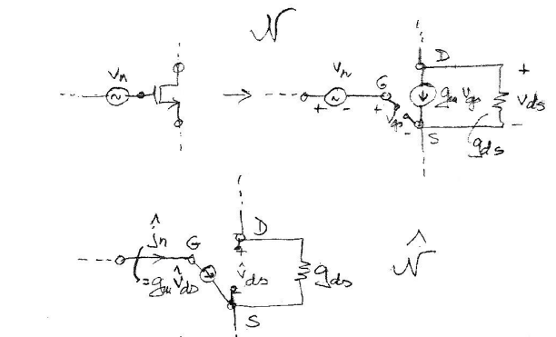
Noise Analysis Using Inter-Reciprocity
Every transistor in CMOS IC is affected by thermal noise (random motion of the channel charge carriers) and by flicker noise or 1/f noise (trapping and releasing of charge carriers).
This noise effect can be modeled by a single independent noise voltage source at the gate of the device.
Inter-reciprocity can be applied to find the output noise.
Notes:
23
23

Slide 24
Noise Analysis Using Inter-Reciprocity
Model each transistor with a transconductance $g_{m}$ and drain-to-source conductance $g_{ds}$.
In the adjoint network, the transconductance is turned around.
Using inter-reciprocity, the contribution of the noise voltage $v_{n}$ to the output noise power will be
$${\left(j_{n}^{′}\right)}^{2}={\left(g_{m}v_{ds}^{′}\right)}^{2}v_{n}^{2} .$$
Notes:
24
24

Slide 25
Sensitivity Analysis Using Inter-Reciprocity
The values of the circuit components will deviate from their theoretical ones when implementing circuits.
The adjoint network is an efficient way to calculate the sensitivities of the key performance parameters, as suggested by Director and Rohrer [4][5].
Assume a two-port containing resistors and VCCSs with all component values having a small error, changing $G$ to $G+ΔG$.
Using the adjoint network $N^{′}$ with its transconductance matrix ${G^{′}=G}^{T}$, we have for the internal branches the change $Δ$Pb $=v_{B}^{T}∙ΔG∙v_{B}^{′}.$ Based on this, the sensitivities of the output to conductances and transconductances can be found.
Notes:
25
25

Slide 26
Process of Sensitivity Analysis
Assume a voltage output $v_{out}$ for the physical circuit N containing resistors and VCCSs. The process is as follows;
Construct the adjoint network N’, in which the values of all independent sources of N are set to zero. Resistive branches remain unchanged, controlled sources replaced by their adjoint models. At the output port, place a current source I = 1 A.
Calculate the branch voltages v_{k}’ across all resistors. According to the discussions above, the contribution of the incremental change ∆G_{k} of an admittance G_{k} to ∆v_{out} will be v_{k}’.v_{k} .∆G_{k .} Thus, the output sensitivity to variations in G_{k} will be ∆v_{out}/ ∆G_{k} = v_{k}’.v_{k .}
To find the sensitivity to changes in the transconductance G_{lm} of a VCCS between branches m and l, find the controlling voltages v_{m} and v_{l}’ in N and N’. The sensitivity is ∆v_{out}/ ∆G_{lm} = v_{l}’.v_{m .}
Notes:
26
26

Slide 27
References
[1] B.D.H. Tellegen, “A general network theorem, with applications,” Philips Res. Rept., 7, pp. 259-269, 1952.
[2] Temes, G.C., “A physical proof of Tellegen’s theorem,” Proc. of the IEEE, 57(6):1183-1184, June 1969.
[3] Bordewijk, J. L., “Inter-reciprocity applied to electric networks,” Appl. Sci. Res., Sec B, pp. 1-74, 1956.
[4] Director, S. W. and Rohrer, R.A., “The generalized adjoint network and network sensitivities,” IEEE Trans. Circuit Theory, Aug. 1969, pp. 318-323.
[5] ] Director, S. W. and Rohrer, R.A., “Automated network design: the frequency domain case,” IEEE Trans. Circuit Theory, Aug. 1969, pp. 330-337.
Notes:
27
27

